Slide 1
FLIGHT PERFORMANCE

Slide 2
Service Ceiling and Absolute Ceiling:
The highest altitude achievable is the altitude where (R/C)max=0. It is defined as the absolute ceiling that altitude where the maximum rate of climb is zero is in steady, level flight.
A more useful quantity is the service ceiling, conventionally defined as the altitude where
(R/C)= 100 ft/min.
The service ceiling represents the practical upper limit for steady, level flight.
For many conventional airplanes, R/C versus altitude is almost linear.
The graphical solution for service and absolute ceilings is straightforward

Slide 3
Rate of Climb:
The vertical component of the velocity is, by definition, the rate of climb of the airplane;
The higher the thrust, the lower the drag, and the lower the weight, the better the climb performance.

Slide 4
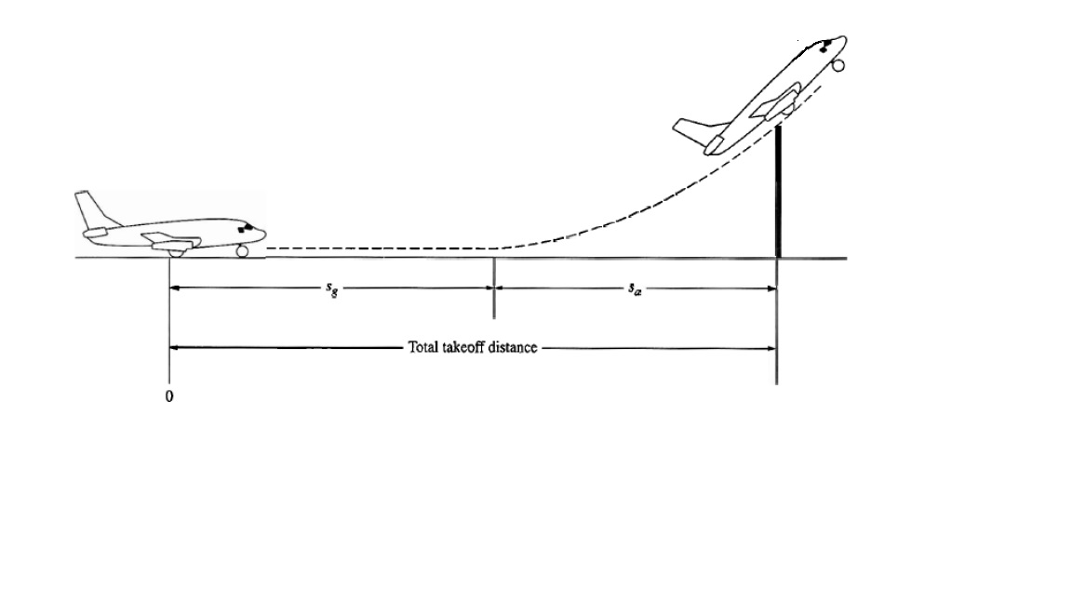
Take-off Performance:

Slide 5
Take-off Performance:
An airplane is motionless at the end of a runway. This is denoted by location O.
The pilot releases the brakes and pushes the throttle to maximum takeoff power, and the airplane accelerates down the runway. The airplane lifts into the air at some distance from its starting point.
The distance the airplane covers along the runway before it lifts into the air is called the ground roll (s_{g}).
The total takeoff distance also includes the extra distance covered over the ground after the airplane is airborne but before it clears an obstacle of 50 ft for military aircraft and 35 ft for commercial aircraft.
This is denoted by s_{a}. The sum of s_{g} and s_{a} is the total takeoff distance.

Slide 6
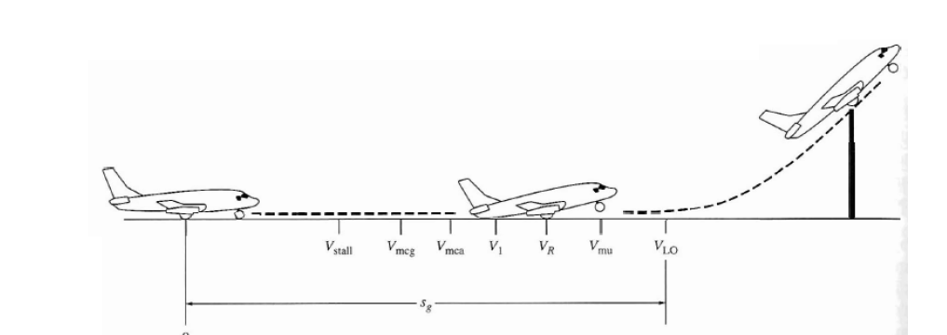
Take-off Performance:

Slide 7
Take-off Performance:
As the airplane accelerates from zero velocity, at some point it will reach the stalling velocity Vstall
The airplane continues to accelerate until it reaches the minimum control speed on the ground, Vmcg. This is the minimum velocity at which enough aerodynamic force can be generated on the vertical fin with rudder deflection while the airplane is still rolling along the ground to produce a yawing moment sufficient to counteract that produced when there is an engine failure for a multiengine aircraft.
If the airplane were in the air (without the landing gear in contact with the ground), the minimum speed required for yaw control in case of engine failure is slightly greater than Vmcg This velocity is called the minirnum control speed in the air, Vmca

Slide 8
Take-off Performance:
The airplane continues to accelerate until it reaches the decision speed, V₁. This is the speed at which the pilot can successfully continue takeoff even though an engine failure (in a multiengine aircraft) would occur at this point.
If an engine fails before V1 is achieved, the takeoff must be stopped.
If an engine fail after V1is reached, the takeoff has to be completed.
The airplane continues to accelerate until the takeoff rotational speed, V_{R} is achieved. At this velocity, the pilot initiates by elevator deflection a rotation of the airplane in order to increase the angle of attack and to overcome the weight. Attention should be paid not to stall.

Slide 9
Take-off Performance:
The angle of attack necessary to overcome the weight may not be achievable because the tail may drag the ground. If the rotation of the airplane is limited by ground clearance for the tail, the airplane must continue to accelerate while rolling along the ground after rotation is achieved. This speed is called the minimum unstick speed, denoted by Vus.
For increased safety, the angle of attack after rotation is slightly less than the maximum allowable by tail clearance, and the airplane continues to accelerate to a slightly higher velocity, called the lift-off speed, denoted by V_{LO}. This is the point at which the airplane actually lifts off the ground. The total distance covered along the ground to this point is the ground roll s_{g}.
Generally V_{LO}=1.1 V_{stall}

Slide 10
Landing Performance:

Slide 11
Landing Performance:
Landing distance begins when the airplane clears an obstacle 50ft height.
At that instant the plane is following a straight approach path with an angle θa.
The velocity Va=1.3 Vstall for civil planes, Va=1.2Vstall for military.
At a distance h_{f} from the ground the airplane flares as a transition to the horizontal ground roll.
The distance measured on the ground from the obstacle to the flare is s_{a}.

Slide 12
Landing Performance:
The distance covered during the flare on the ground is s_{f}.
The velocity at touchdown is V_{td}=1.15V_{stall} (1.1V_{stall} for military).
After the touchdown there is a Free roll distance before the pilot uses the brakes (the velocity is assumed constant to V_{td}).
The distance up to the point where velocity is 0, is the ground roll s_{g}.

Slide 13
Landing Performance:
for transport aircraft θ<3. Hence, cos(θ) is about 1

Slide 14
Gliding Flight:
Whenever an airplane is flying such that the power required is larger than the power available, it will descend rather than climb.
In the ultimate situation, there is no power at all; in this case, the airplane will be in gliding.
This will occur for a conventional airplane when the engine quits during flight (e.g., engine failure).
Also, this is the case for gliders and sailplanes.

Slide 15
Gliding Flight:
The higher the L/D, the shallower the glide angle. The smallest equilibrium glide angle occurs at (L/D)max.

Slide 16
Level Turn Flight:
A level turn is one in which the curved flight path is in a horizontal plane parallel to the plane of the ground; that is, in a level turn the altitude remains constant.
The centrifugal force is balanced by the
radial force L sin(φ).

Slide 17
Level Turn Flight:
The two performance characteristics of greatest importance in turning flight are:
1. The turn radius R.
2. The turn rate ω. The turn rate is simply the local angular velocity of the airplane
along the curved flight path.
These characteristics are particularly germane to combat aircraft. For superior dog
fighting capability, the airplane should have the smallest possible turn radius R and
the fastest possible turn rate.
Hence, the lift vector L controls the turn when a pilot goes to turn the airplane, she
or he rolls the airplane in order to point the lift vector in the general direction of the
turn.
Keep in mind that L and φ are not independent:

Slide 18
Level Turn Flight:
L/ W is an important parameter in turning performance; it is defined as the
load factor n, where:
The roll angle depends on the load factor only;
if you know the load factor, then you know the roll angle, and vice-versa.

Slide 19
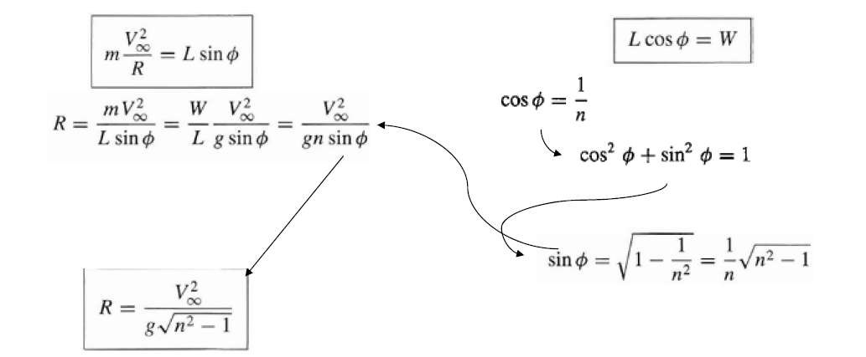
Level Turn Flight:
The turn radius depends only on V and n. To obtain the smallest possible R, we need
The highest possible load factor (i.e. the highest possible L/ W).
2. The lowest possible velocity.

Slide 20
Level Turn Flight:
To obtain an expression for the turn rate the largest possible turn rate, we want
The highest possible load factor.
The lowest possible velocity.

Slide 21

Range is the total distance (measured with respect to the ground) traversed by an airplane on one load of fuel.

Slide 22



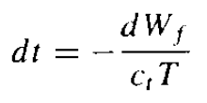
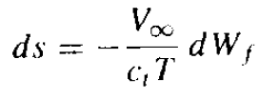

Slide 23
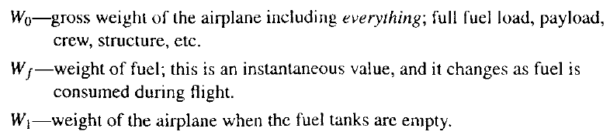

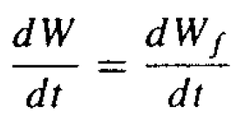
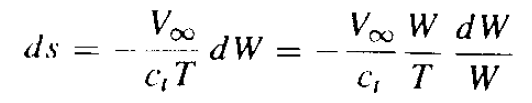

Slide 24
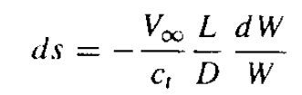
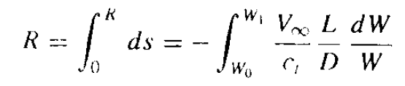
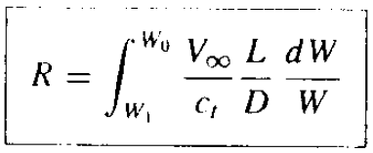

Slide 25
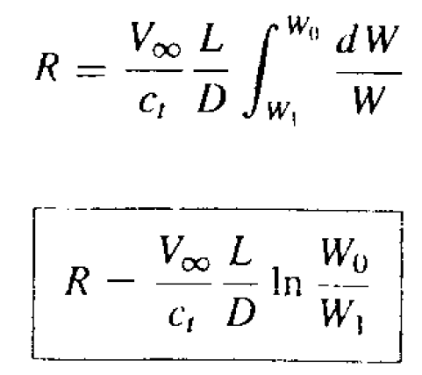


Slide 26
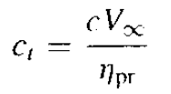
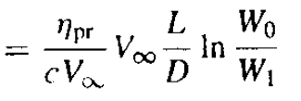
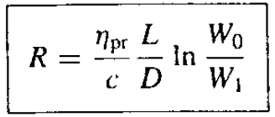

Slide 27

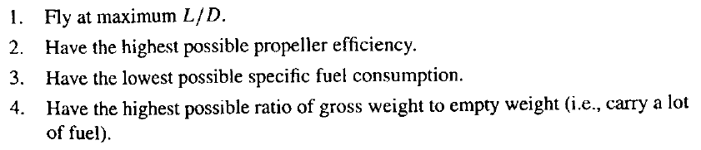

Slide 28


Slide 29
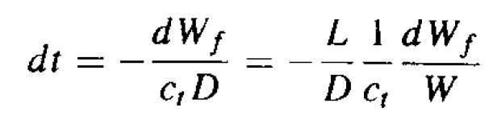
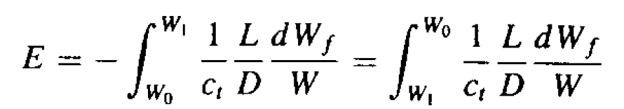

Slide 30
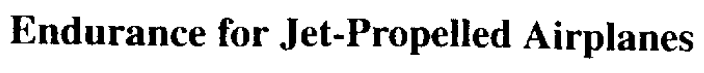
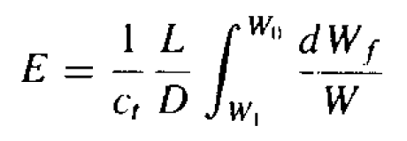
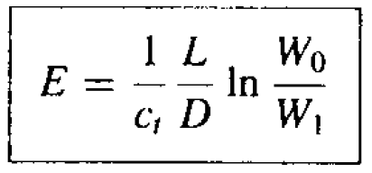

Slide 31
